Slide 1
Initial Requirements & Use Cases

Slide 2
First Step
Understand the problem
What is the database supposed to provide?
Don’t just rush out and “build a database”

Slide 3
Need to understand:
What tasks will people carry out with the database?
What data is needed to support those tasks

Slide 4
Understand the problem domain
“The analyst needs to immerse himself in the problem domain so deeply that he begins to discover nuances that even those who live with … [it] … every day have not fully considered.”

Slide 5
Analyst view
The analyst tries to take real world descriptions and turn them into an abstract model
Something which suites the example described but will extend to future situations
Must understand the input and output requirements
Immediate requirements
Potential requirements

Slide 6
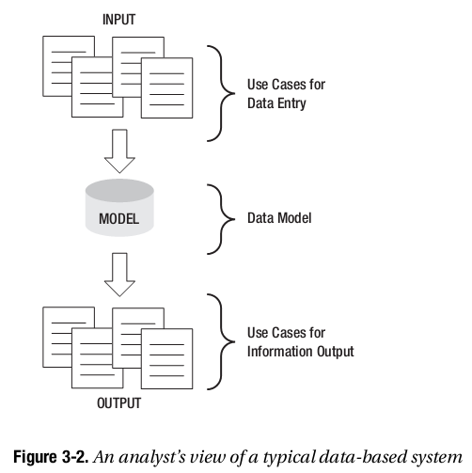
Analyst view of a data-based system
Notes:
The first thing an analyst must do is understand the problem in sufficient detail to help determine the input and output requirements (both immediate and potential). These can be expressed as Use cases.

Slide 7
Multiple perspectives
An individual client seldom has a clear picture of the whole problem
Database projects tend to be either
Data-minding
Task Automation

Slide 8
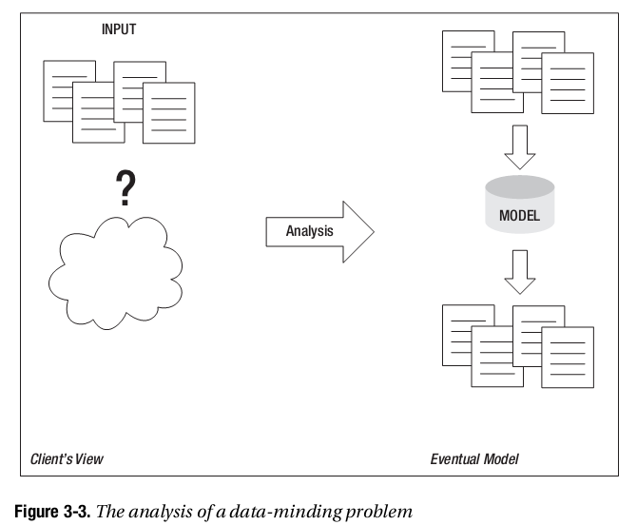
Data Minding
Data needs to be looked after
Predicting potential output requirements is essential
Notes:
Knowing the data is in there… but not being able to get it out in a convenient manner.

Slide 9
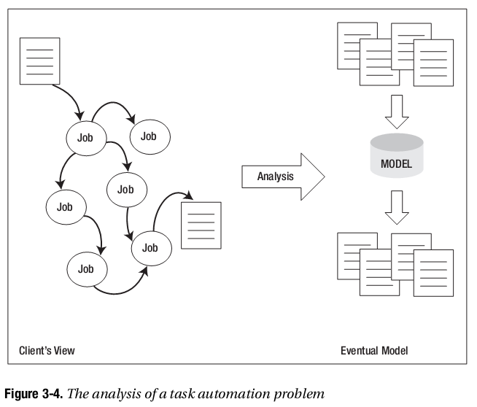
Task Automation
Jobs need to be automated
Clients often have clear idea of output need
Need to be careful about input selection
Notes:
A typical description for a task automation problem at a local school might go like this:
When parents call up to say that children are sick, we have to let their classroom teachers know, and if it’s sports day and the child is on a school team, the sports teacher might have to sort out substitutes. Then we need to count up all the days missed to put on the child’s report. The Department of Education needs the totals each term, too.
Recording the absence and being able to report it in several ways are clearly prime requirements. However, what about the sports teams? Does the system need to differentiate those children on teams (and if so does it need to know which teams)? Does the system need to know on which dates there are interschool matches? Probably not. Differentiating what the client does (if it’s sports day, tell the sports teacher) from what needs to be recorded is part of the scoping process. The eventual solution for the sports part of the problem may be as complicated as recording all the details about teams, substitutes, and match dates, or may be as simple as handing the sports teacher a list of everyone who is absent each day and letting her sort it out.
Every problem is different, so we need a general framework for discovering and representing the intricacies of a database problem. A good start is to determine answers to the following questions

Slide 10
Important questions
What does the user do?
What data is involved?
What is the main objective of the system?
What data is needed to satisfy this objective?
What are the input use cases?
What is the first data model?
What are the output use cases?

Slide 11
Example to consider
Visitors to the city staying in local motel or hotel rooms are offered a service that will deliver them a variety of fast food or takeaway meals (pizzas, burgers, Chinese takeout, and so on).
The visitor phones the company and places an order for some meals. A driver is selected and dispatched to pick up the meals from the appropriate fast-food outlets. The driver delivers the meals to the customer, receives the payment, and informs the depot. He also fills in a time sheet, which he returns to the depot later.
One of the reasons given for wanting to automate this, currently manual, process is to be able to produce statistics about the numbers of orders taken and about the time taken to complete orders.

Slide 12
Q1: What does the user do?
Particularly relevant for task automation
But applicable to data-minding too
Examine what people currently do
Pre-database – what happens currently?
Who does what?
Notes:
Receptionist records details of order (address, phone number, meals, total price)
Receptionist selects a driver and gives him information about the order
Driver picks up the meal(s) from fast food outlet
Driver delivers meal and informs depot
Driver hands in time sheet at the end of his shift
Receptionist or manager produces weekly and monthly statistics.

Slide 13
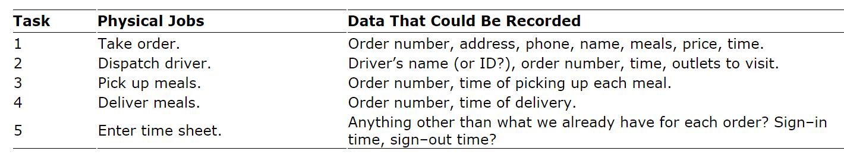
Q2: What Data is Involved?
What data is involved in the previous tasks?

Slide 14
Q3: What is the objective of the system?
A meal ordering system could be quite small or massive
List orders & display
Track customers, orders, ingredients, stock, staff hours & wages …
What do we need it to do?

Slide 15
Objective for problem
To record orders for meals so that summaries of the number, value, and overall time taken to process orders can be retrieved for different time periods.

Slide 16
Q4: What data is required to satisfy the objective?
What do we need to know to:
Take order?
Dispatch driver?
Pick up meals?
Deliver meals?
Enter time sheets?

Slide 17
Restating the meal delivery problem
The system will record and provide information about meals and their current prices.
It will maintain data about orders including the date, the meals requested, and contact information for the customer and the driver assigned to the delivery.
It will also maintain the time the order was placed and the time it was finally delivered. Given this, the system will be able to provide summary information about the number and value of orders within particular time periods and also summaries of the time taken for total processing of orders.
The system will not maintain any additional information about drivers. The system will not maintain any information about outlets nor which were used for any particular order.

Slide 18
Q5: What are the input use cases?
Try to stay at the user-task level
“something small enough that a user could do in less than about twenty minutes and then go off and have a coffee”.
But - “should be a job significant enough so that if a user did several of the tasks in a day he could use it as evidence for a raise.”
What data is needed to input ?

Slide 19
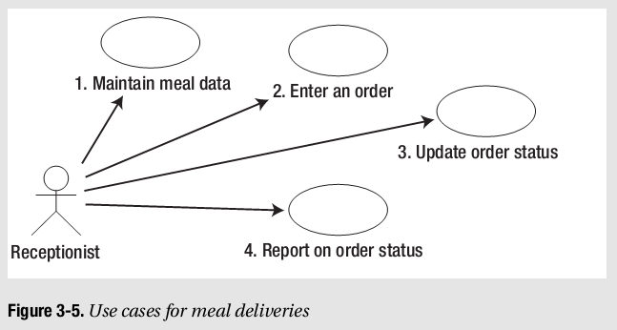
Initial Use Case
Note: Each case MUST have a description

Slide 20
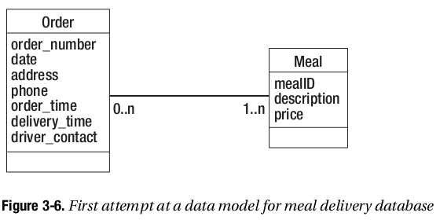
Q6: What is the First Data Model
What entities/classes have been discovered?
What are the classes attributes ?
What is the relationship between the classes?

Slide 21
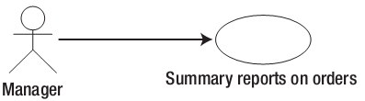
Q7: What are the Output Use Cases
Given the data we have, what reports would the business value?
Does this indicate new classes or entities?
Food type?
Look at adjusting model

Slide 22
Use Cases - Actors
Actors
Represents a user of our database
Important to consider roles and their requirements for the database
A small business may have many roles for each person
A large enterprise may have many people in each role

Slide 23
Use Cases - Exceptions
Include exceptions in the text description of a use case
If someone says “most of the time we do xxxx”
Explore what happens the other times
Always explore “what could possibly go wrong”
Because it will go wrong and your system needs to cope.

Slide 24
Use Cases – Maintaining Data
Classic gotcha for B.IT projects!
All entities should (normally) be able to be:
Create
Read
Update
Delete
CRUD is a method to ensure that processes exist to do all of these
Helps identify gaps in process design
Excellent as a final review

Slide 25
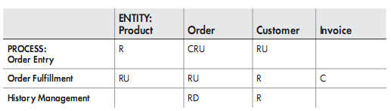
CRUD Example
List entities or classes as columns
Use cases as rows
Identify (as initials) which use-case Create, Read, Update or Delete from an entity

Slide 26
CRUD identifies potential problems
Entities that have no Create process
Entities that have no Delete process
Entities that are never updated
Entities that are never read
Use-cases that delete or update entities without reading them
Use-cases that only read (no Create, Delete, or Update actions)

Slide 27
Finding out more about the problem
Don’t just talk to clients
Examine forms already in use
Examine reports already being created
The organisation already performs the tasks – how do they do it?
What are the business processes currently?

Slide 28
Finally – Identify what is postponed
There will be tasks and use-cases which will not be performed or developed
Identify them – acknowledge what will not be included in the initial database
May lead on to further development
Sets client expectations about what is, and is not possible in the initial database.

Slide 29
Exercise
A budget system for personal/home use
What does the user do?
What data is involved?
What is the main objective of the system?
What data is needed to satisfy this objective?
What are the input use cases?
What is the first data model?
What are the output use cases?

Slide 30
Read
Chapter 3: Initial Requirements and Use Cases

